Slide 1

Sequences

Slide 2
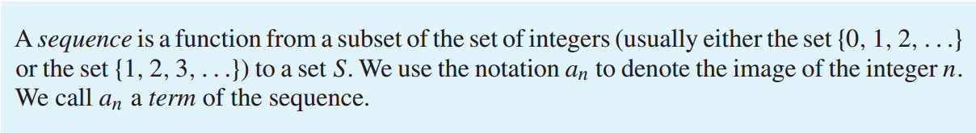
Sequences
Definition
Arithmetic Sequences
Geometric Sequences
Recurrence Relations Sequences

Slide 3
Sequences
We all know this sequence of numbers! What is the rule?
1 2 3 4 5 6 7 8 9
Of course its add one!
In today's lesson we are going to be looking at lots of different sequences!

Slide 4
Sequences
Look at these number sequences carefully can you guess the next 2 numbers?
What about guess the rule?
+10
30
40
50
60
70
80
+3
---------------------------------------------------------------------------------------------------------------------
17
20
23
26
29
32
-7
---------------------------------------------------------------------------------------------------------------------
48
41
34
27
20
13

Slide 5
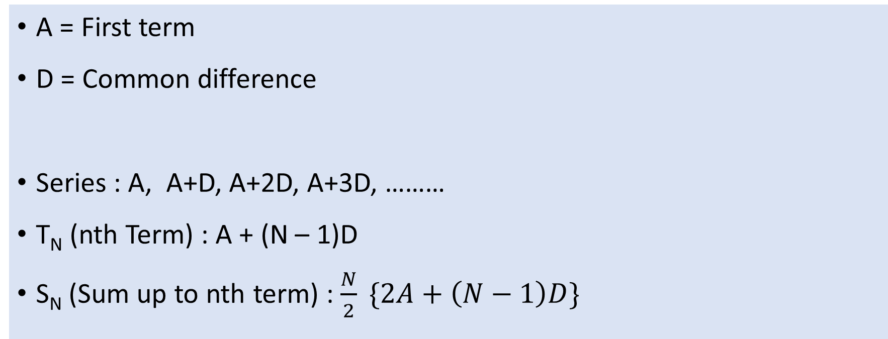
Arithmetic Sequences
A = First term
D = Common difference
Series : A, A+D, A+2D, A+3D, ………
T_{N} (nth Term) : A + (N – 1)D
S_{N} (Sum up to nth term) : $\frac{N}{2} \{2A+\left(N−1\right)D\}$

Slide 6
Sequences
Now try these sequences – think carefully and guess the last number!
+1, +2,
+3 …
1
2
4
7
11
16
---------------------------------------------------------------------------------------------------------------------
double
3
6
12
24
48
96

Slide 7
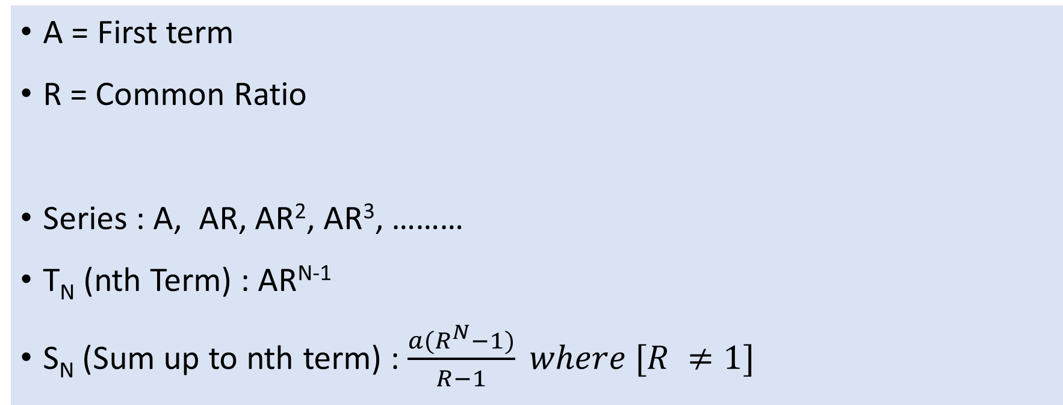
Geometric Sequences
A = First term
R = Common Ratio
Series : A, AR, AR², AR³, ………
T_{N} (nth Term) : AR^{N-1}
S_{N} (Sum up to nth term) : $\frac{a(R^{N}−1)}{R−1} where [R ≠1]$

Slide 8
Recurrence Relations Sequences
Always need to look back!

Slide 9
Recurrence Relations Sequences
Guess my rule!
For these sequences I have done 2 maths functions!
3
7
15
31
63
127
x2 +1
x2 -1
2
3
5
9
17
33

Slide 10


Fibonacci’s Series
This is a really famous number sequence which was discovered by an Italian mathematician a long time ago.
It is called the Fibonacci sequence and can be seen in many natural things like pine cones and sunflowers!!!
1 1 2 3 5 8 13 21 etc…
Can you see how it is made? What will the next number be?
34!
See if you can find out something about Fibonacci!

Slide 11
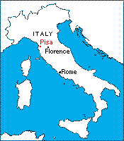
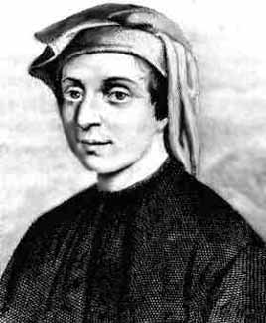
Who Was Fibonacci?
~ Born in Pisa, Italy in 1175 AD
~ Full name was Leonardo Pisano
~ Grew up with a North African education under the Moors
~ Traveled extensively around the Mediterranean coast
~ Met with many merchants and learned their systems of arithmetic
~ Realized the advantages of the Hindu-Arabic system

Slide 12
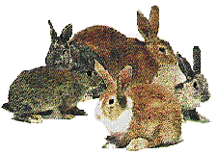
Fibonacci’s Rabbits
Problem:
Suppose a newly-born pair of rabbits (one male, one female) are put in a field. Rabbits are able to mate at the age of one month so that at the end of its second month, a female can produce another pair of rabbits. Suppose that the rabbits never die and that the female always produces one new pair (one male, one female) every month from the second month on. How many pairs will there be in one year?

Slide 13
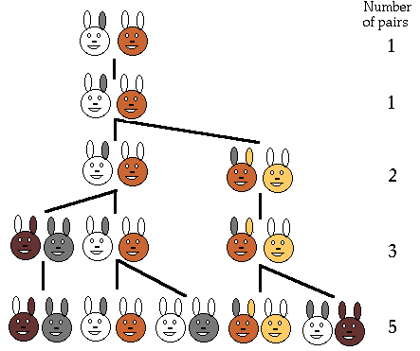
Fibonacci’s Rabbits Continued
~ End of the first month = 1 pair
~ End of the second month = 2 pair
~ End of the third month = 3 pair
~ End of the fourth month = 5 pair
~ 5 pairs of rabbits produced in one year
1, 1, 2, 3, 5, 8, 13, 21, 34, …

Slide 14

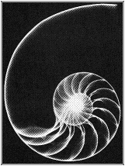
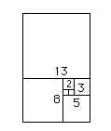

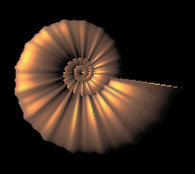
The Fibonacci Numbers in Nature
~ Fibonacci spiral found in both snail and sea shells

Slide 15

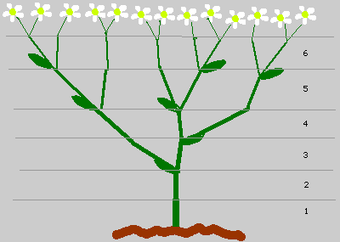
The Fibonacci Numbers in Nature
~ Sneezewort (Achillea ptarmica) shows the Fibonacci numbers

Slide 16
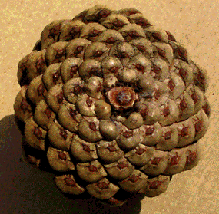
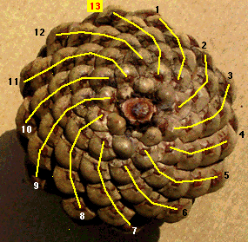
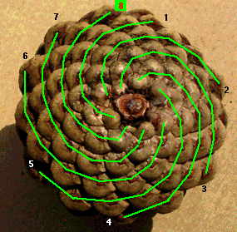
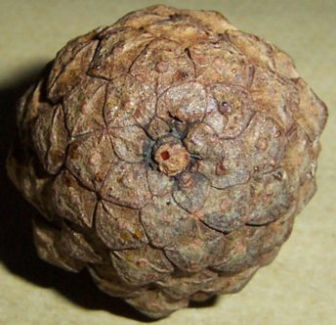
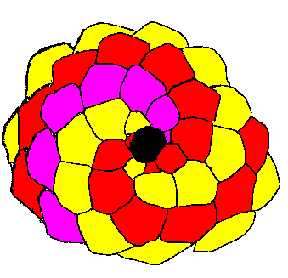
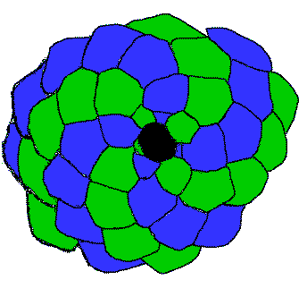
The Fibonacci Numbers in Nature
~ Pinecones clearly show the Fibonacci spiral

Slide 17


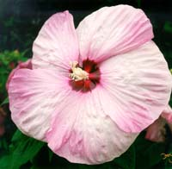

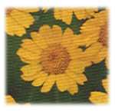
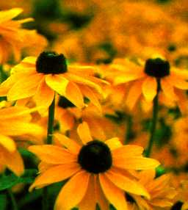
The Fibonacci Numbers in Nature
Lilies and irises = 3 petals
Buttercups and wild roses = 5 petals
Corn marigolds = 13 petals
Black-eyed Susan’s = 21 petals

Slide 18
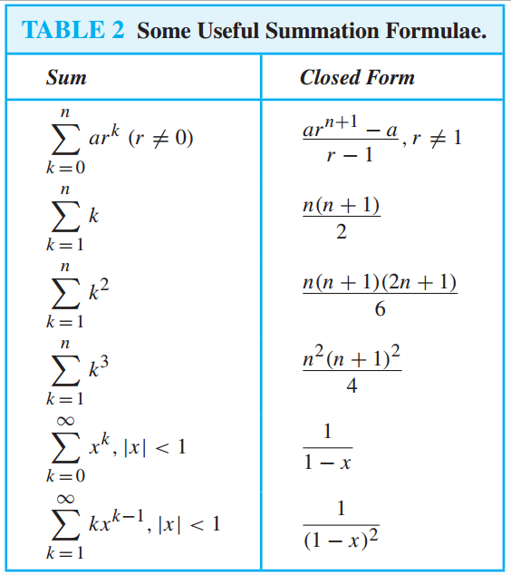
Summation of Sequences

